Slide 1
Hanoi Towers

Slide 2
Purpose of Hanoi Towers
The purpose of the Hanoi Towers is a mathematical puzzle that consists of three towers and a number of disks of different sizes, which can slide onto any tower. The puzzle starts with all the disks stacked in increasing order of size on one tower, with the largest disk at the bottom and the smallest at the top. The goal is to transfer the entire stack of disks from one tower to another.

Slide 3
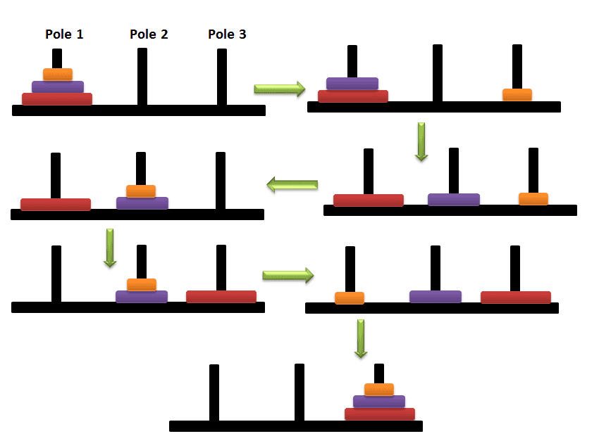
Rules
Only one disk can be moved at a time.
Each move consists of taking the top disk from one of the stacks and placing it on top of another stack.
A larger disk cannot be placed on top of a smaller disk.

Slide 4
Definition of Problem

Slide 5
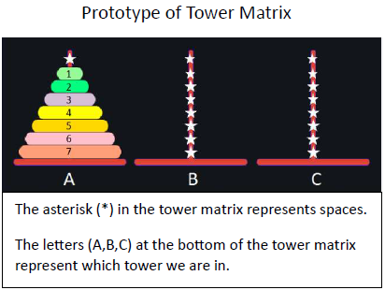
State

Slide 6
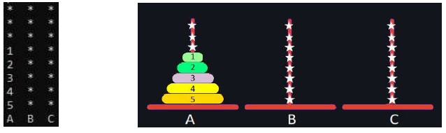
Initial State
Console
In real life

Slide 7
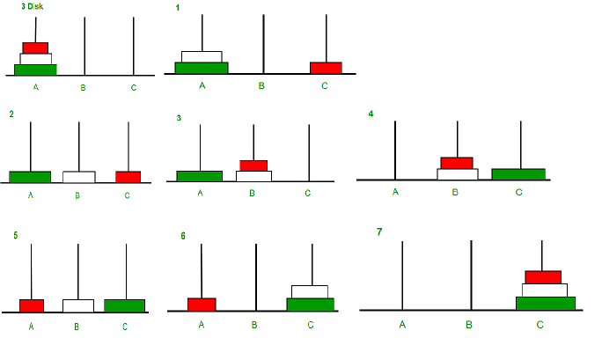
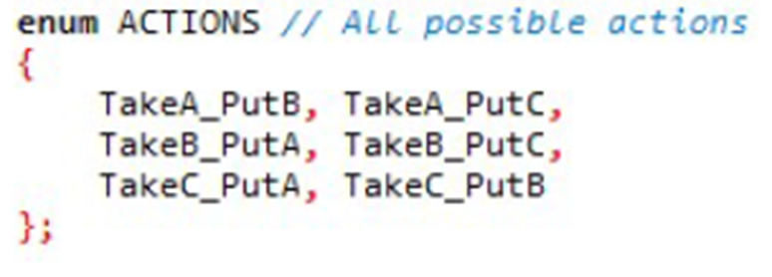
Actions

Slide 8
Heuristic Function

Slide 9
Definition of Heuristic Function
Returns the number of disks in the current state that differ in location from the disks in the goal state. Heuristic function’s value is 0 when it is in the goal state.

Slide 10
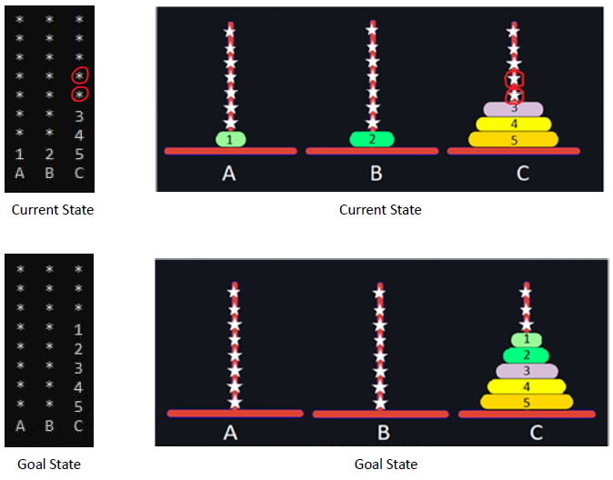
Example of Heuristic Function
There is an example. As seen here, there is a code of current and goal state of hanoi towers. In the right side, we see the real-life equivalent of the code. As I said, heuristic function returns the number of disks in the current state that differ in location from the disks in the goal state. In current state, we can say that 1 and 2 is not in C tower. So heuristic function will return 2.

Slide 11
A* Algorithm

Slide 12
What is A* Algorithm?
The A* algorithm is a popular pathfinding algorithm used in computer science and artificial intelligence.
The A* algorithm finds the shortest path between a starting node and a goal node in a graph or a grid. It evaluates the nodes in the graph based on two values: the cost of reaching that node from the start node, denoted as g(n), and an estimate of the cost to reach the goal from that node, denoted as h(n). The sum of these two values, f(n) = g(n) + h(n), is used to prioritize the order in which nodes are explored.
At each step, the algorithm examines the node with the lowest f(n) value and expands it by considering its neighboring nodes.
It also keeps track of the closed set, which contains the nodes that have already been visited.
The A* algorithm continues to expand nodes and update their g(n) and f(n) values until the goal node is reached

Slide 13
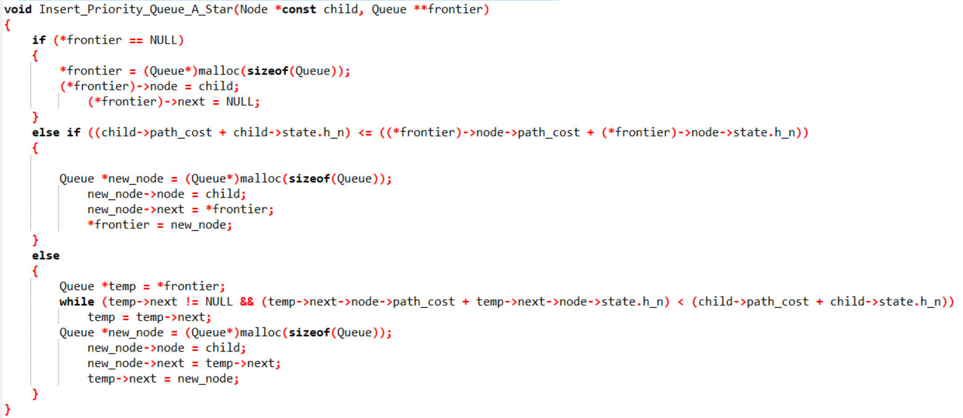

Slide 14
Result of Several Simulations

Slide 15
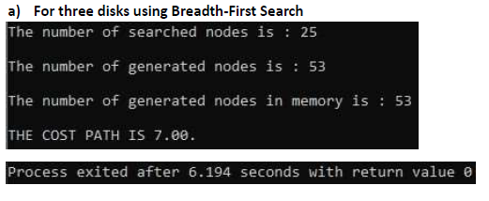

Slide 16
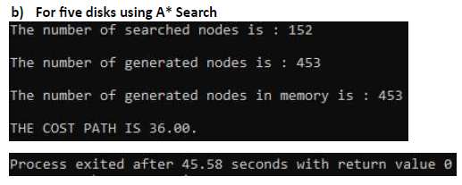

Slide 17
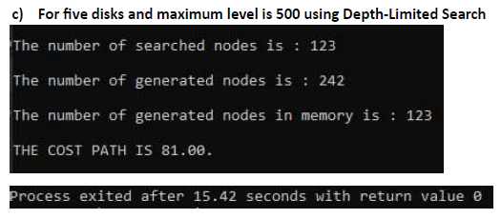

Slide 18
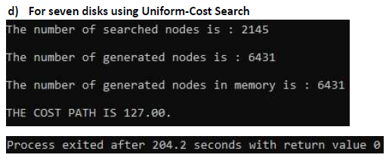

Slide 19
Reports

Slide 20
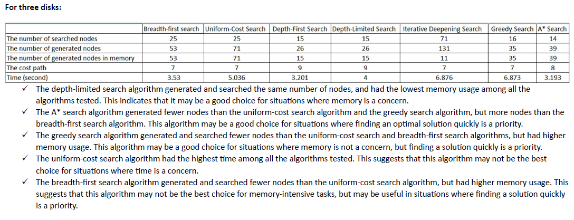

Slide 21
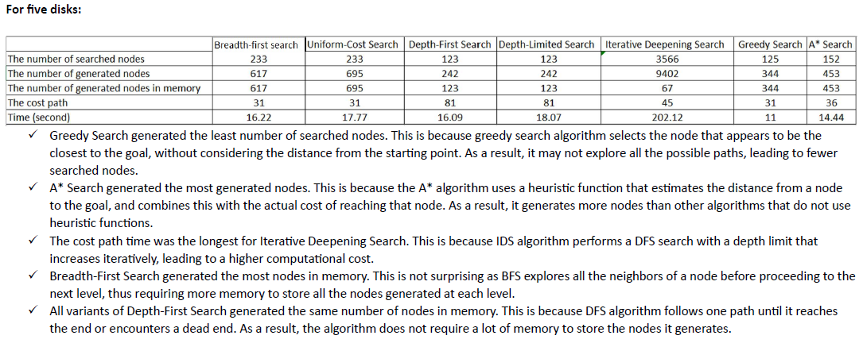

Slide 22
THANKS FOR WATCHING!

